Slide 1
Reporting
Session 20

Slide 2
The reporting structure of a business is designed to enable employees to hit company targets most effectively.
The way a company is structured depends on numerous factors, such as company size, type of business, geographic locations, products and services, current projects and individual expertise.
For many businesses, the corporate structure can change based on external elements such as the economy or internal factors such as turnover.

Slide 3
The reporting structure is a key element of the organizational chart because it identifies how and where company authority flows. Organizational charts clarify what functions employees perform, the manager to whom they report and whether any employees report to them.
In some organizational structures, an employee can report to multiple managers for different elements of their job description.
In certain cases, employees who are not direct managers can hold authority with regard to their functional expertise.

Slide 4
Traditional Vertical reporting structure
One of the most common reporting structures is a traditional vertical organization, where the person at the top has the most authority.
This person can be the CEO, business owner or other executive. He guides the people underneath him, who further manage the employees at the bottom of the organizational chart.
Visually, this kind of reporting structure looks like a pyramid, with the most powerful person at the top and the least powerful people at the bottom.

Slide 5
The number of layers within the pyramid will depend on the size of the business. For many small businesses, there may only be two layers: the business owner and all the employees.
There may not be any need for middle management if the business has few employees because the business owner may be able to oversee them all.
As the business expands, the owner may wish to add a layer of management between herself and the employees so she can focus on other elements of the business aside from overseeing employees.

Slide 6
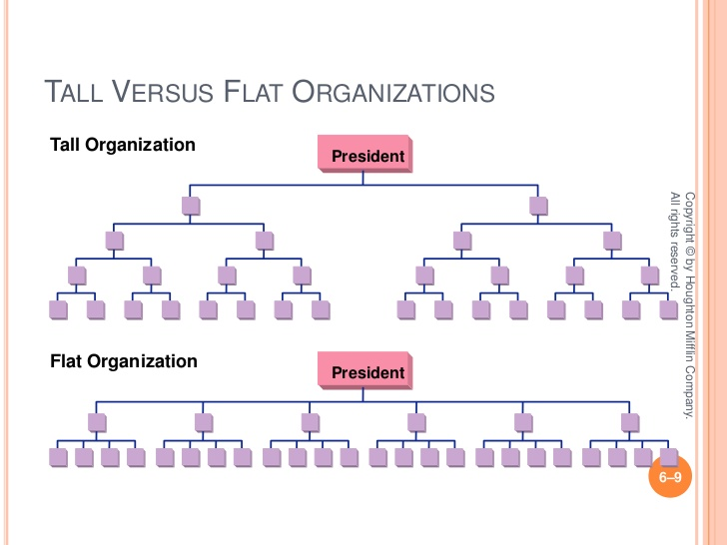

Slide 7
Functional reporting structure
A variation of the traditional vertical reporting structure is the functional reporting relationship. In this kind of organizational model, people are grouped by the kind of job they do. People who work on similar kinds of tasks are overseen by a manager who has expertise in that particular function of the organization.
For example, all marketing employees are overseen by a marketing manager, and all research and development employees are overseen by a research and development manager.

Slide 8
The marketing executive may report to a marketing manager who may report to the CEO. Like the traditional reporting structure, the functional reporting structure can have as many or as few layers of management as needed.
In a small business, for example, there may be a customer service department of two people who are overseen by a customer service manager who can also be the business owner.

Slide 9
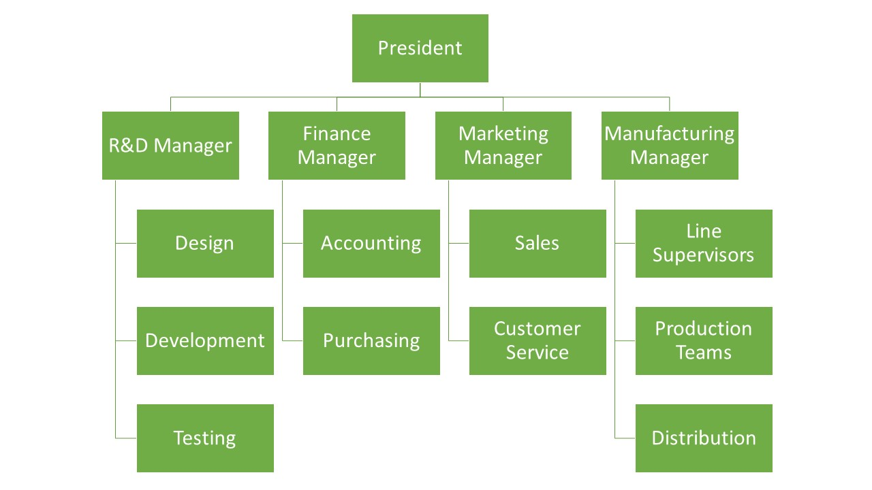

Slide 10
Divisional or product reporting structure
For larger organizations that have different products or sales channels, a divisional reporting structure might work best. This is also a variation on the traditional vertical reporting structure. However, in this case, the company is organized based on product line or product division.
For example, the consumer packaged goods division may have its own vertical hierarchy, and the clothing division may have its own completely separate vertical hierarchy. The leaders of both groups would then report to an executive team that manages the entire organization.

Slide 11
Business chain-of-command titles in this case may include Marketing Associate – Consumer Packaged Goods, Marketing Manager – Consumer Packaged Goods and Marketing Director – Consumer Packaged Goods.
The clothing division would have similar titles like Marketing Associate – Clothing and Accessories, Marketing Manager – Clothing and Accessories and Marketing Director – Clothing and Accessories.
The two Marketing Directors might then report to the same Marketing VP who would hold authority for all marketing in the company.

Slide 12
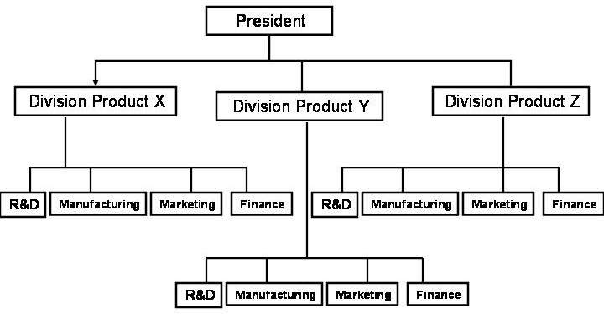

Slide 13
LINE AND STAFF REPORTING STRUCTURE
The line-and-staff reporting structure is a variation on the vertical hierarchy that also includes horizontal authority. Line refers to positions within the business that are involved in daily operations required to run the company, such as sales or manufacturing. As a result, sales departments and manufacturing or production departments are line positions with line personnel and line managers.
Staff refers to positions within the company that indirectly support the daily operations of the business and those with line roles. Human resources departments and legal departments are usually categorized as staff and are composed of staff personnel and staff managers.

Slide 14
Staff roles can have indirect authority over line roles, as they provide functional expertise that is required to run the business. For example, in a small business, there may be one human resources professional. While he may not directly manage the sales teams, he is there to provide support and expertise to that department. If the sales manager wanted to hire another salesperson, she would likely have to clear it with the human resources professional and get his approval.

Slide 15
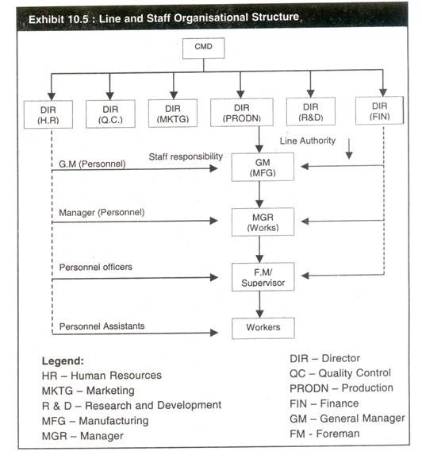

Slide 16
Flat reporting relationship
A flat reporting structure is when decision making is spread throughout an organization. This means that there are no managers or senior-level employees. Everyone in the organization has equal authority. This kind of organizational model is easier to implement in small- and medium-sized businesses rather than larger ones.
Flat organizations are sometimes called self-managed companies, which means that each employee takes responsibility for ensuring she meets her company goals. In order for a flat organization to succeed, a sense of equality needs to be rooted in the company culture, mission and values. Sometimes, informal hierarchies can take place based on employee expertise or seniority.

Slide 17
In a small business, a flat structure can be successful if each employee brings specific functional expertise and experience. For example, if a bakery has a cake specialist and a bread specialist plus a customer service specialist, a flat business model ensures they all have equal reign over their respective areas and have to work together to meet the goals of the bakery.

Slide 18
Matrix organization structure
Matrix reporting structures combine at least two different kinds of organizational models based on the current business needs. This kind of reporting structure is a dynamic one that changes according to the company’s current projects and objectives.
Most commonly, matrix reporting structures combine the functional and divisional reporting structures. Sometimes, matrix structures also include a geographical component.

Slide 19
Matrix structures, which are also called hybrid structures, are best suited for larger businesses that have multiple products, divisions or campaigns. For example, if a business is launching a new product line for pet snacks, they may create a matrix reporting structure.
The marketing manager may report to the pet snacks product director for the duration of the product planning and launch period in addition to her own marketing director. This way, when working on the launch, she can directly communicate with both directors to ensure greater visibility and control.

Slide 20
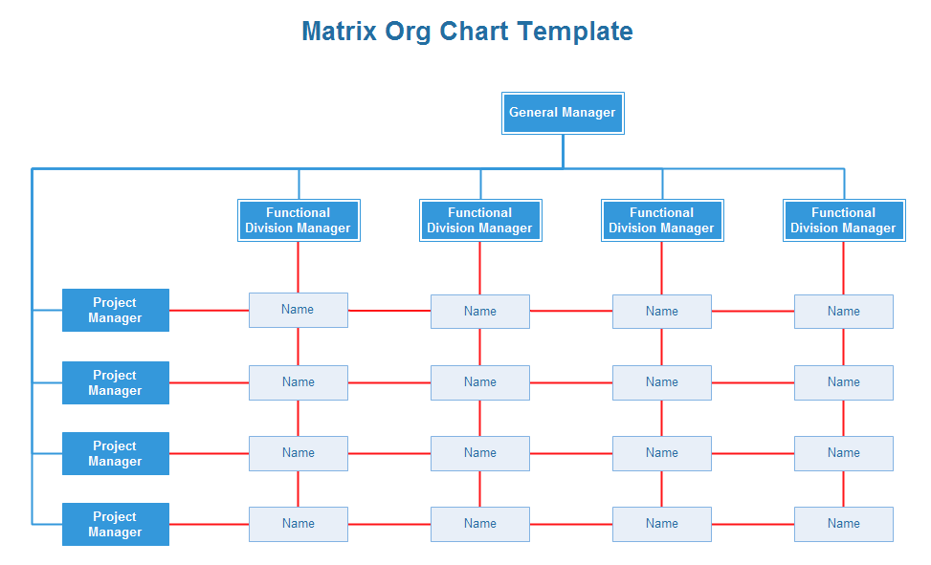

Slide 21
Creating a Company Reporting Structure for Your Business
Regardless of which reporting structure you choose for your business, it’s important to ensure it aligns with your current and future business goals. If you are planning on growing the business, for example, be sure to use an organizational model that can scale with you.
It’s also important to provide stability and clarity for employees so they always know what their job description is and how they fit into the company as a whole.

